Slide 1

Health Monitoring and History Maintenance of Stray Dogs
PROJECT
Presenter Name
Dept of Computer Science & Engineering

Slide 2
Abstract
The increasing population of stray dogs and the lack of proper monitoring mechanisms have made it difficult to maintain an accurate count and ensure their health and well-being. Many stray dogs go untracked, leading to challenges in identifying their health conditions, managing disease outbreaks, and maintaining medical history. This lack of monitoring often results in missed opportunities for timely medical intervention and effective disease control. Additionally, the absence of a centralized system to track and monitor these animals hinders collaboration among veterinarians, NGOs, and local authorities.
Dept of Computer Science & Engineering

Slide 3
Certificate
Paste your internship Certificate
Dept of Computer Science & Engineering

Slide 4
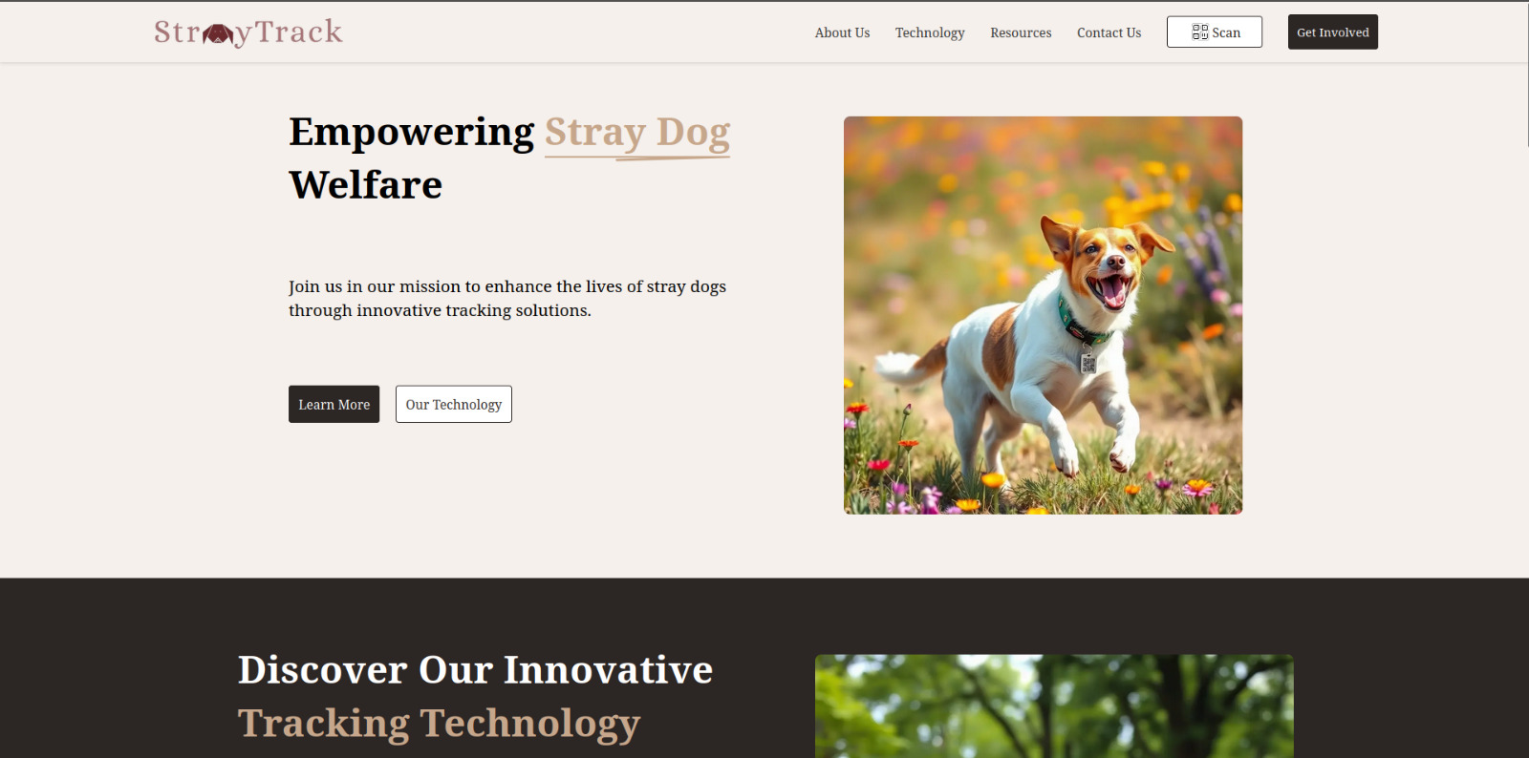
Health Monitoring and Disease Control in Stray Dogs
Dept of Computer Science & Engineering

Slide 5
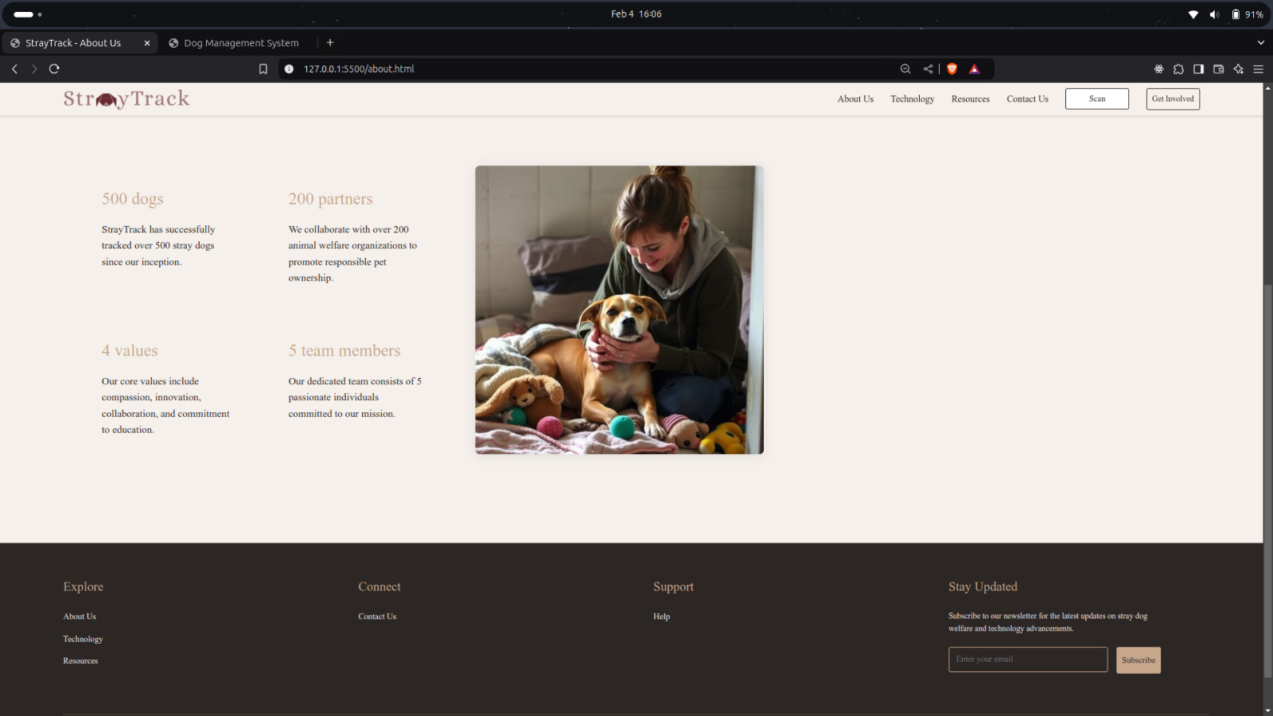
About Us – StrayTrack’s Mission & Impact
Dept of Computer Science & Engineering

Slide 6

Innovating technology Stray Dog Welfare
Dept of Computer Science & Engineering

Slide 7
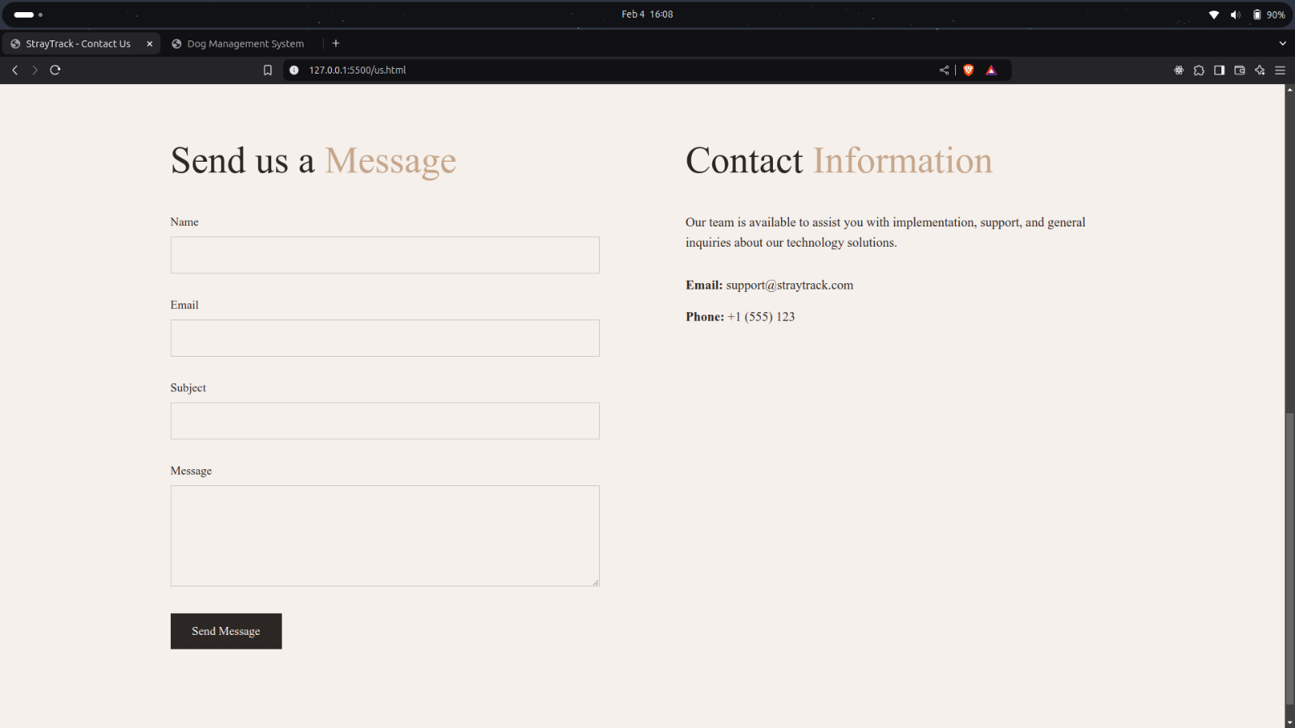
Contact Us
Dept of Computer Science & Engineering

Slide 8
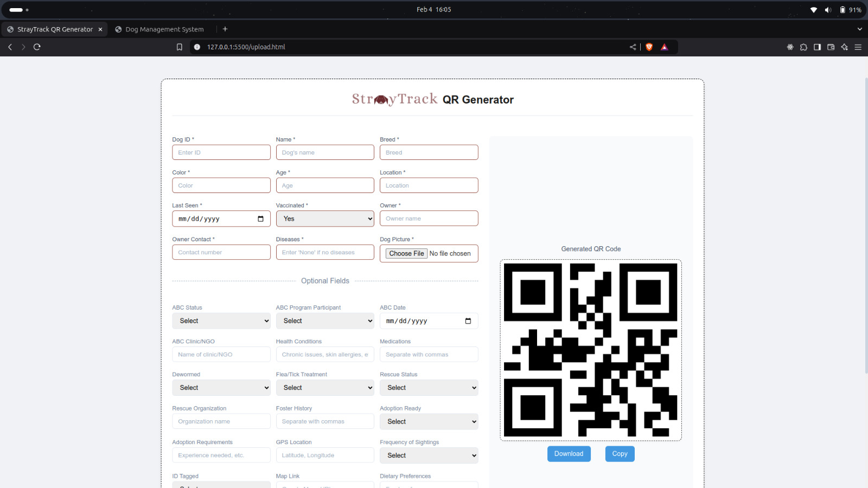
StrayTrack QR Generator – Register & Track Stray Dogs
Dept of Computer Science & Engineering

Slide 9
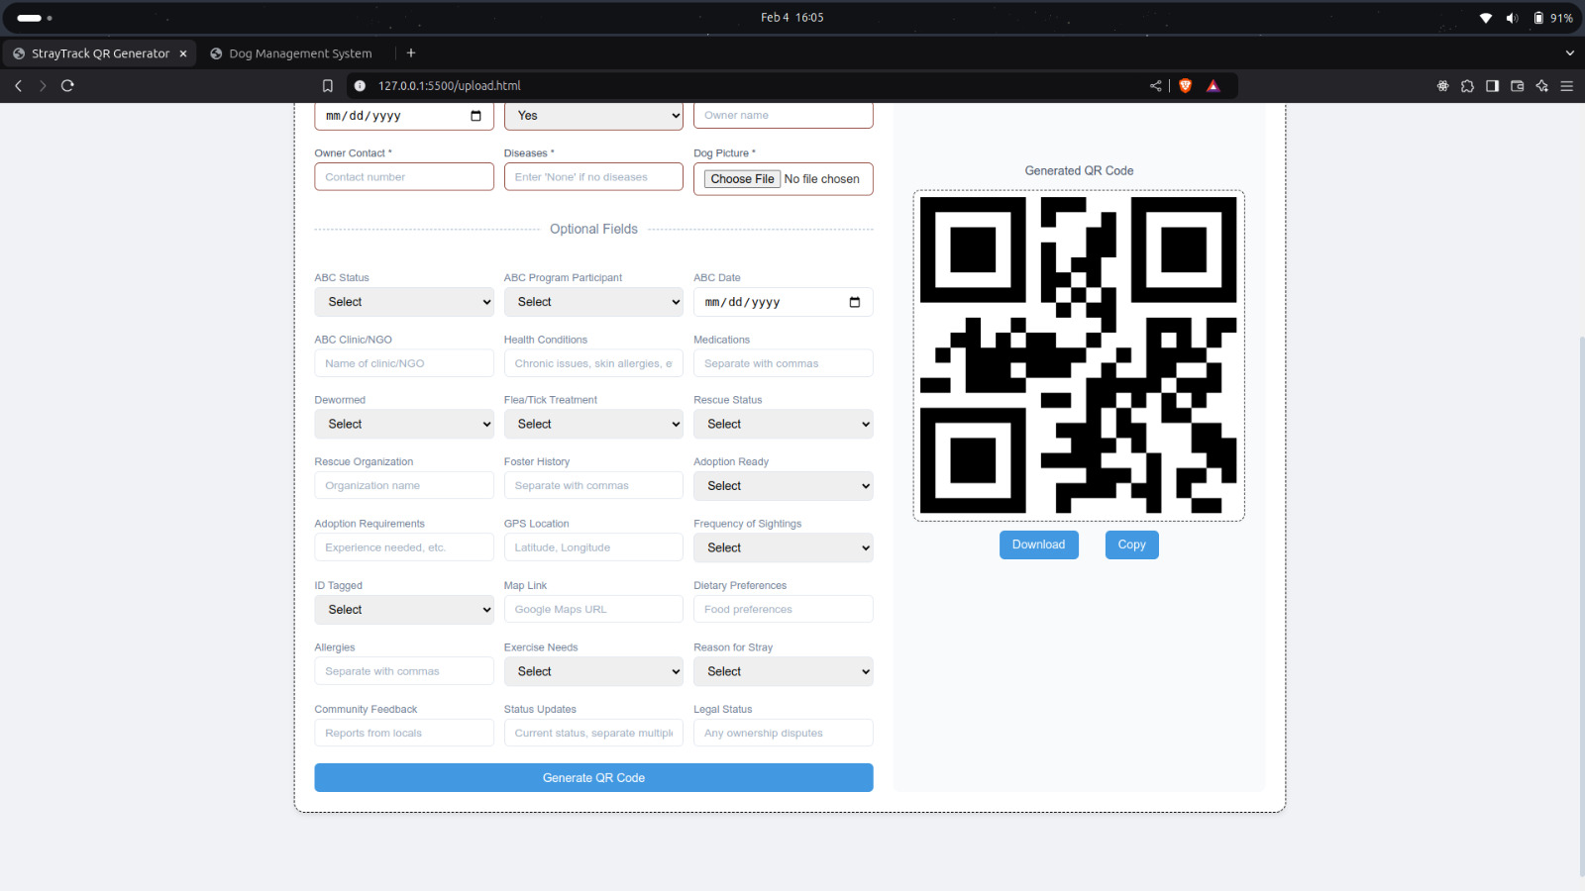
StrayTrack QR Generator – Register Details & Track Stray Dogs
Dept of Computer Science & Engineering

Slide 10

QR Code Sample

Slide 11
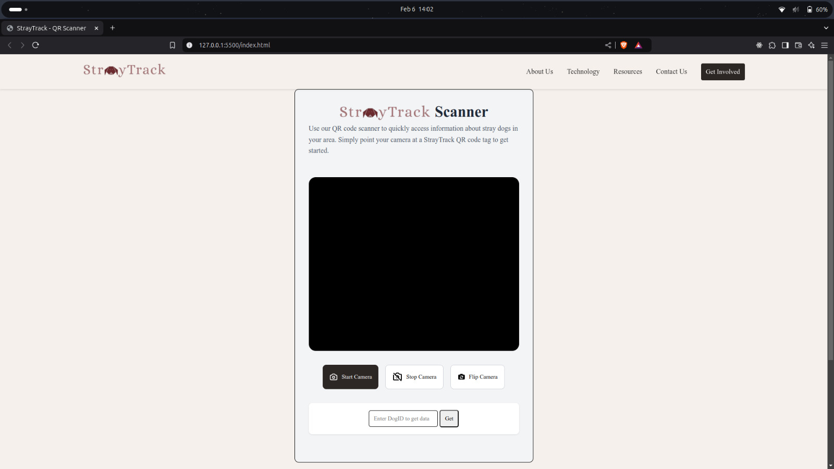
QR - Scanner
Dept of Computer Science & Engineering

Slide 12
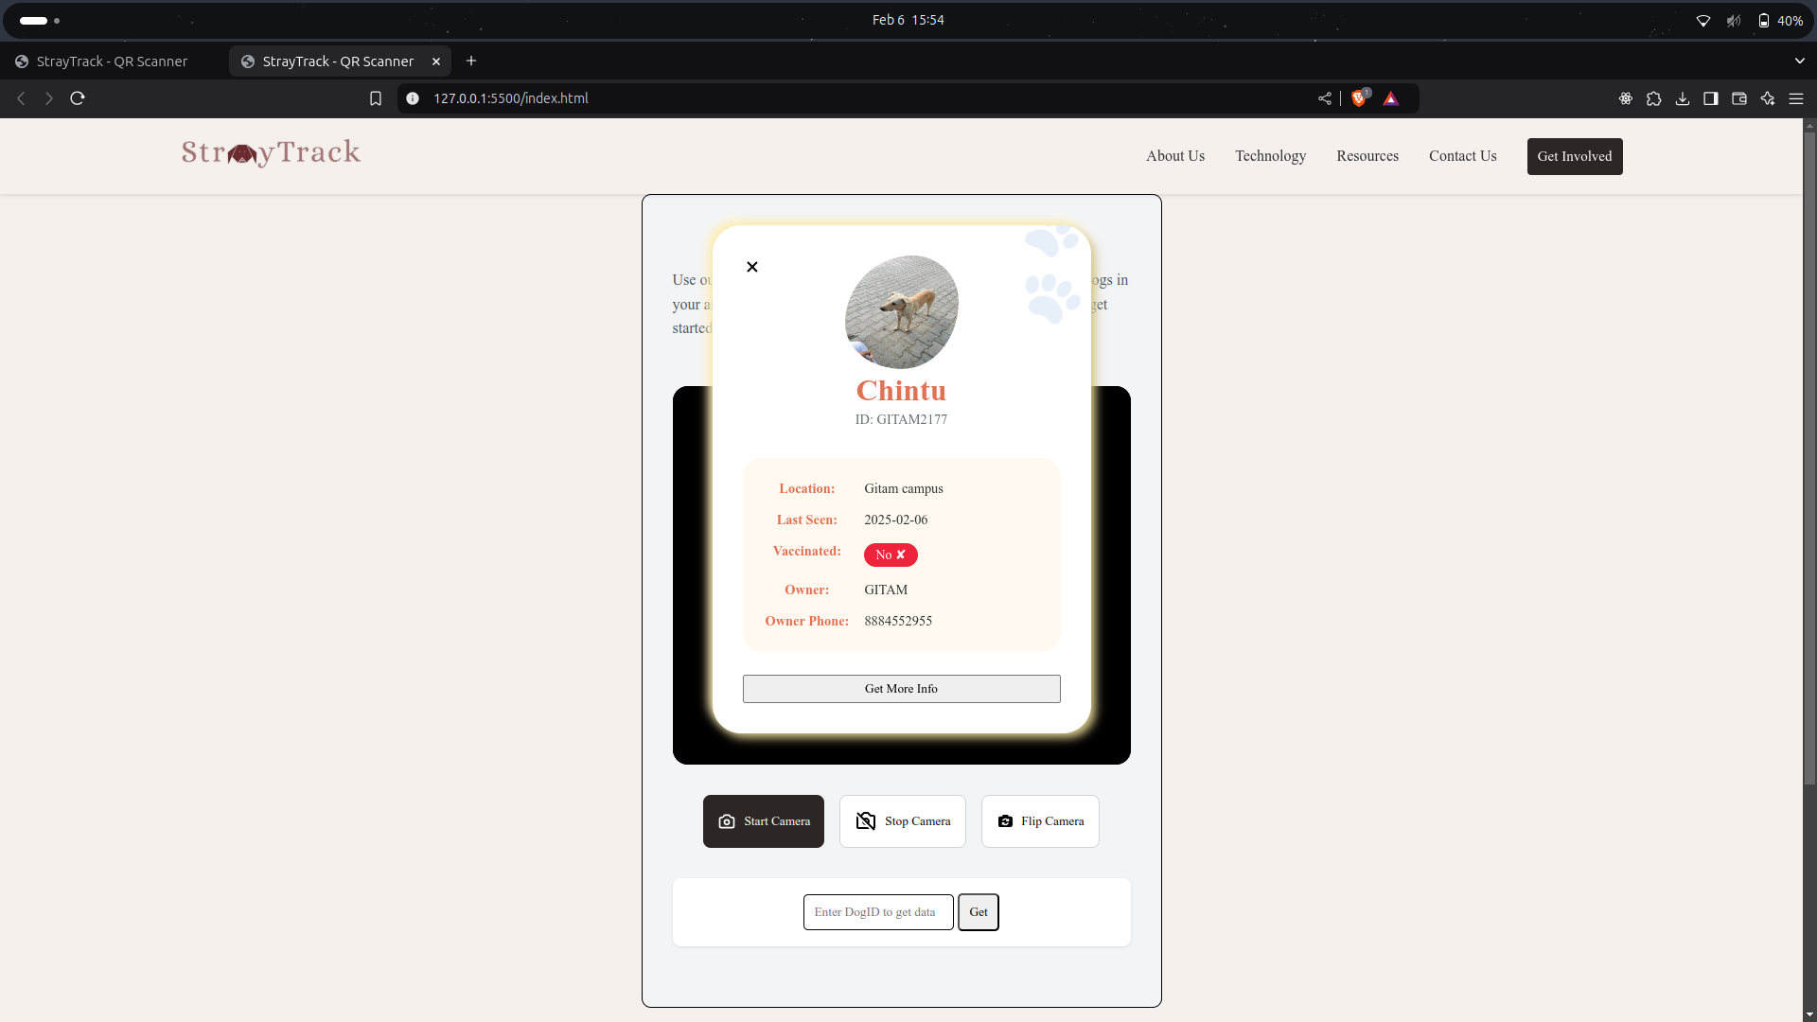
QR Code Scanner & Dog Information Retrieval
Dept of Computer Science & Engineering

Slide 13
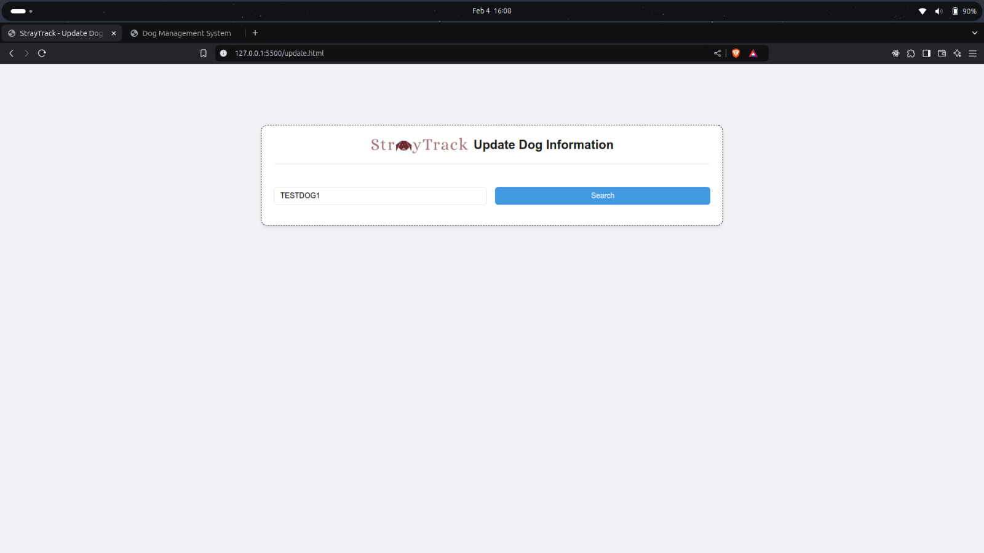
“StrayTrack – To Update Dog Information Using Id"
Dept of Computer Science & Engineering

Slide 14
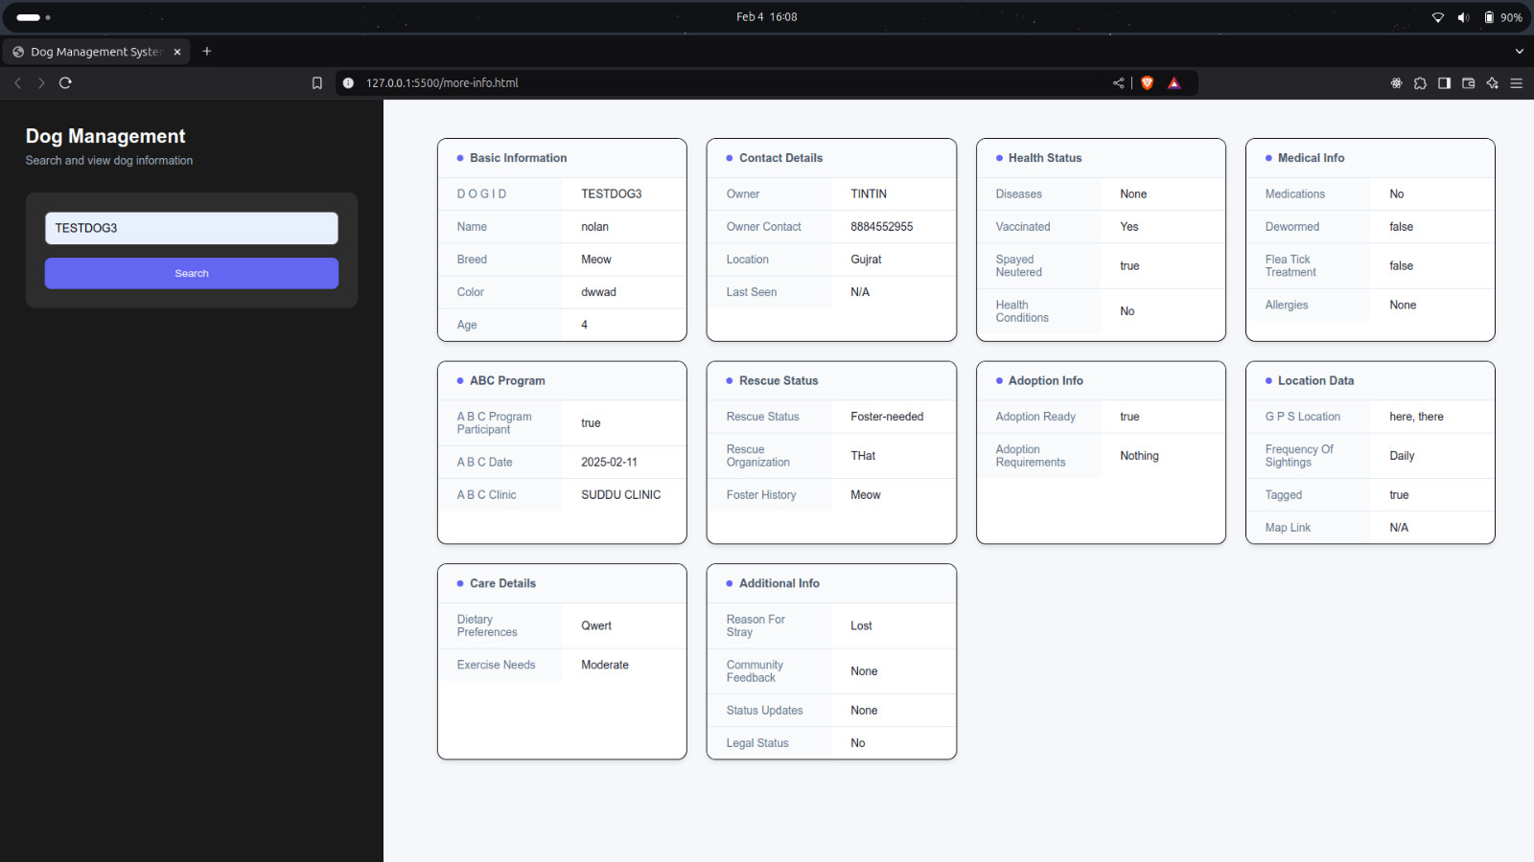
Dog data Management System: Enhancing Animal Welfare and Operational Efficiency By Entering Dog ID
Dept of Computer Science & Engineering

Slide 15
Thank You
Dept of Computer Science & Engineering

